Slide 1
Chapter 5: Relations and Functions
謝孫源 講座教授
hsiehsy@mail.ncku.edu.tw
國立成功大學 資訊工程系

Slide 2
Outline
Cartesian Products and Relations
Functions: Plain and one-to-one
Onto Functions: Stirling Numbers of the Second Kind
Special Functions
The Pigeonhole Principle
Function Composition and Inverse Function

Slide 3
Cartesian Products (1/4)
Definition 5.1: For sets A, B⊆U, the Cartesian product, of A and B is denoted by A×B and equals {(a, b)| a∈A, b∈B}.
the elements of A×B are ordered pairs.
|A×B|=|A|•|B|
A×B=B×A?
If n∈Z⁺, n≥3, and A₁, A₂,…, A_{n}⊆U, the n-fold product of A₁, A₂,…, A_{n}, denoted by A₁×A₂×…×A_{n}, equals {(a₁, a₂,…, a_{n})| a_{i}∈A_{i},1≤i≤n}. The elements of A₁×A₂×…×A_{n} are called ordered n-tuples.

Slide 4
Cartesian Products (2/4)
Definition 5.1 (cont.):
If (a₁, a₂,…, a_{n}), (b₁, b₂,…, b_{n})∈A₁×A₂×…×A_{n},
then (a₁, a₂,…, a_{n})=(b₁, b₂,…, b_{n}) iff a_{i}=b_{i} for all
1≤i≤n.
Example 5.1: Let U={1, 2, 3,…, 7}, A={2, 3, 4}, B={4, 5}. Then
a) A×B={(2, 4), (2, 5), (3, 4), (3, 5), (4, 4), (4, 5)}.
b) B×A={(4, 2), (4, 3), (4, 4), (5, 2), (5, 3), (5, 4)}.
c) B² =B×B={(4, 4), (4, 5), (5, 4), (5, 5)}.
d) B³=B×B×B={(a, b, c)|a, b, c∈B}; for instance,
(4, 5, 5)∈B³.

Slide 5
Cartesian Products (3/4)
An experiment E conducted as follows: A single die is rolled and its outcome noted, and then a coin is flipped and its outcome noted. Determine a sample space for I for E.
Let E ₁ denote the first part of experiment E , and let I₁={1, 2, 3, 4, 5, 6} be a sample space for E₁. Likewise let I₂={H, T} be a sample space for E₂, the second part of the experiment. Then I=I₁×I₂ is a sample space for E .

Slide 6
Cartesian Products (4/4)
(1, H)
(1, T)
(2, H)
(2, T)
(3, H)
(3, T)
(4, H)
(4, T)
(5, H)
(5, T)
(6, H)
(6, T)
1
2
3
4
5
6

Slide 7
Relation (1/4)
Definition 5.2: For sets A, B⊆U, any subset of A×B is called a Relation from A to B. Any subset of A×A is called a binary relation on A.
Example 5.5: U={1, 2, 3,…, 7}, A={2, 3, 4}, B={4, 5}
With A, B, U as in Example 5.1, the following are
Relations from A to B.
a) Ø b) {(2, 4)}
c) {(2, 4), (2, 5)} d) {(2, 4), (3, 4), (4, 4)}
e) {(2, 4), (3, 4), (4, 5)} f) A×B

Slide 8
Relation (2/4)
In general, for finite sets A, B with |A|=m and |B|=n, there are 2^{mn} relations from A to B, including the empty relation as well as the relation A×B itself.
There are also 2^{nm}(=2^{mn}) relations from B to A, one of which is also Ø and another of which is B×A. The reason we get the same number of relations from B to A as we have from A to B is that any relation R ₁ from B to A can be obtained from a unique relation R ₂ from A to B by simply reversing the components of each ordered pair in R ₂.

Slide 9
Relation (3/4)
Example 5.6: Let B={1, 2}⊆N, U=P (B) and A=U={Ø, {1}, {2}, {1, 2}}.
The following is an example of a binary relation on
A:R ={(Ø, Ø), (Ø, {1}), (Ø, {2}), (Ø, {1, 2}), ({1}, {1}),
({1}, {1, 2}), ({2}, {2}), ({2}, {1, 2}), ({1, 2}, {1, 2})}.
We can say that the relation R is the subset
relation where (C, D)∈R if and only if C, D⊆B and
C⊆D.
For any set A⊆U, A×Ø=Ø and Ø×A=Ø.

Slide 10
Relation (4/4)
Theorem 5.1: For any sets A, B, C⊆U:
a) A×(B∩C)=(A×B)∩(A×C)
b) A×(B∪C)=(A×B)∪(A×C)
c) (A∩B)×C=(A×C)∩(B×C)
d) (A∪B)×C=(A×C)∪(B×C)
Pf: For any a, b∈U
(a, b)∈A×(B∩C)⇔a∈A and b∈B∩C
⇔a∈A and b∈B, C
⇔a∈A, b∈B and a∈A, b∈C
⇔(a, b)∈A×B and (a, b)∈A×C
⇔(a, b)∈(A×B)∩(A×C)

Slide 11
Outline
Cartesian Products and Relations
Functions: Plain and one-to-one
Onto Functions: Stirling Numbers of the Second Kind
Special Functions
The Pigeonhole Principle
Function Composition and Inverse Function

Slide 12
Function (1/2)
Definition 5.3: For nonempty sets A, B, a function, or mapping, f from A to B, denoted f :A→B, is a relation from A to B in which every element of A appears exactly once as the first component of an ordered pair in the relation.
(a, b) is an ordered pair in the function ƒ
也記作 f (a)=b a: a preimage of b
b: the image of a under f .
(a, b), (a, c)∈f implies b=c.

Slide 13
Function (2/2)
Example 5.9: For A={1, 2, 3} and B={w, x, y, z}, f ={(1, w), (2, x), (3, x)} is a function, and consequently a relation, from A to B. R ₁={(1, w), (2, x)} and R ₂= {(1, w), (2, w), (2, x), (3, z)} are relations, but not functions, from A to B. (Why?)

Slide 14
Domain and Range (1/3)
Definition 5.4: For the function ƒ:A→B, A is called the domain of ƒ and B the codomain of ƒ. The subset of B consisting of those elements that appear as second components in the ordered pairs of ƒ is called the range of ƒ and is also denoted by ƒ(A) because it is the set of images (of the elements of A) under ƒ.

Slide 15
Domain and Range (2/3)
f
f(A)
f(a)=b
•
•
a
A
B
Figure 5.4

Slide 16
Domain and Range (3/3)
For the general case, let A, B be nonempty sets with |A|=m, |B|=n. Consequently, if A={a₁, a₂,…, a_{m}} and B= {b₁, b₂,…, b_{n}}, then a typical function f :A→B can be described by {(a₁, x₁), (a₂,x₂) ,…,(a_{m}, x_{m})}. We can select any of the n elements of B for x₁ and then do the same for x₂. (We can select any element of B for x₂ so that the same element of B maybe selected for both x₁ and x₂.) We continue this selection process until one of the n elements of B is finally selected for x_{m}. In this way, using the rule of product there are n^{m}=|B|^{|A|} functions from A to B.

Slide 17
Injective (1/2)
Definition 5.5: A function ƒ:A→B is called one-to-one, or injective, if each element of B appears at most once as the image of an element of A.
Example 5.14: Let A={1, 2, 3} and B={1, 2, 3, 4, 5}. The function f ={(1, 1), (2, 3), (3, 4)} is a one-to-one function from A to B; g={(1, 1), (2, 3), (3, 3)} is a function from A to B, but it fails to be one-to-one because g(2)=g(3) but 2≠3.

Slide 18
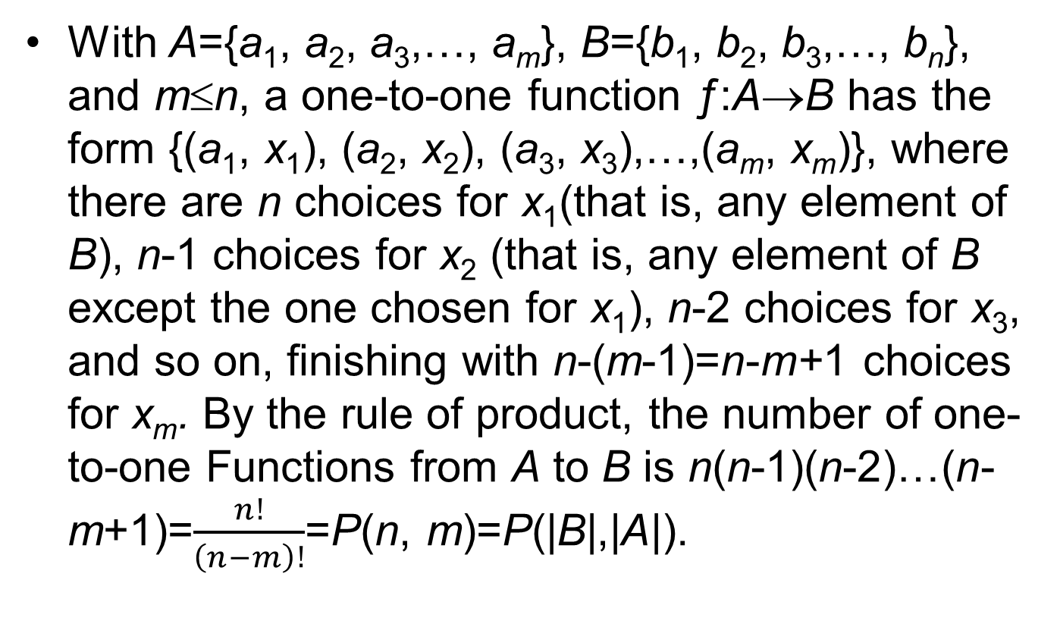
Injective (2/2)
With A={a₁, a₂, a₃,…, a_{m}}, B={b₁, b₂, b₃,…, b_{n}}, and m≤n, a one-to-one function ƒ:A→B has the form {(a₁, x₁), (a₂, x₂), (a₃, x₃),…,(a_{m}, x_{m})}, where there are n choices for x₁(that is, any element of B), n-1 choices for x₂ (that is, any element of B except the one chosen for x₁), n-2 choices for x₃, and so on, finishing with n-(m-1)=n-m+1 choices for x_{m}. By the rule of product, the number of one-to-one Functions from A to B is n(n-1)(n-2)…(n-m+1)=$\frac{n!}{\left(n−m\right)!}$=P(n, m)=P(|B|,|A|).

Slide 19
Image (1/2)
Definition 5.6: If ƒ:A→B and A₁⊆A, then f (A₁)={b∈B|b=f(a), for some a∈A₁}, and f (A₁) is called the image of A₁ under f .
Example 5.15: For A={1, 2, 3, 4, 5} and B={w, x, y, z}, let ƒ:A→B be given by f ={(1, w), (2, x), (3, x), (4, y), (5, y)}. Then for A₁={1}, A₂ ={1, 2}, A₃ ={1, 2, 3}, A₄ = {2, 3}, and A₅ ={2, 3, 4, 5}, we find the following corresponding images under f :f (A₁)={f (a)|a∈A₁}={f (a)|a∈{1}}={f (a)|a=1}={f (1)}={w};

Slide 20
Image (2/2)
Example 5.15 (cont.):
f(A₂)={f(a)|a∈A₂}={f (a)|a∈{1, 2}}={f (a)|a=1 or
2}={f(1), f(2)}={w, x}; f(A₃)={f(1), f(2), f(3)}={w, x},
and f(A₃)=f(A₂) because f(2)=x=f(3); f(A₄)={x};
and, f(A₅)={x, y}.

Slide 21
Restriction and Extension (1/4)
Theorem 5.2: Let ƒ:A→B, with A₁, A₂⊆A. Then
a) f(A₁∪A₂)= f(A₁)∪f(A₂).
b) f(A₁∩A₂)⊆ f(A₁)∩f(A₂).
c) f(A₁∩A₂)=f(A₁)∩f(A₂) when f is injective.
Pf: For any b∈B, b∈f(A₁∩A₂)⇒b=f(a) for some
a∈A₁∩A₂
⇒b=f(a) for some
a∈A₁, and
b=f(a) for some
a∈A₂

Slide 22
Restriction and Extension (2/4)
⇒b∈f(A₁) and b∈f(A₂)
⇒b∈f(A₁)∩f(A₂)
∴ f(A₁∩A₂)⊆ f(A₁)∩f(A₂)
Definition 5.7: If ƒ: A→B and A₁⊆A, then f |_{A1}: A₁→B is called the restriction of ƒ to A₁ if f|_{A1}(a)=f(a) for all a∈A₁.
Definition 5.8: Let A₁⊆A and ƒ: A₁→B. If g: A→B and g(a)=f(a) for all a∈A₁, then we call g an extension of f to A.

Slide 23
Restriction and Extension (3/4)
Example 5.18: Let A={w, x, y, z}, B={1, 2, 3, 4, 5}, and A₁= {w, y, z}. Let ƒ: A→B, g: A₁→B be represented by the diagrams in Fig. 5.5. Then g: f |A₁ and f is an extension of g from A₁ to A. We note that for the given function g: A₁→B, there are five ways to extend g from A₁ to A.

Slide 24
Restriction and Extension (4/4)
ƒ: A→B
g: A₁→B
• 1
• 2
• 3
• 4
• 5
• 1
• 2
• 3
• 4
• 5
w
x
y
z
w
y
z
Figure 5.5

Slide 25
Outline
Cartesian Products and Relations
Functions: Plain and one-to-one
Onto Functions: Stirling Numbers of the Second Kind
Special Functions
The Pigeonhole Principle
Function Composition and Inverse Function

Slide 26
Surjective (1/8)
Definition 5.9: A function ƒ: A→B is called onto, or surjective, if f(A)=B—that is, if for all b∈B there is at least one a∈A with f(a)=b.
Example 5.21: If A={1, 2, 3, 4} and B={x, y, z}, then f₁={(1, z), (2, y), (3, x), (4, y)} and f₂={(1, x), (2, x), (3, y), (4, z)} are both functions from A onto B. However, the function g={(1, x), (2, x), (3, y), (4, y)} is not onto, Because g(A)={x, y}⊂B.

Slide 27
Surjective (2/8)
For finite sets A, B with |A|=m and |B|=n, there are
onto functions from A to B.

Slide 28
Surjective (3/8)
Example 5.26: If A={a, b, c, d} and B={1, 2, 3}, then there are 36 onto functions from A to B or, equivalently, 36 ways to distribute four distinct objects into three distinguishable containers, with no container empty (and no regard for the location of objects in a given container). Among these 36 distributions we find the following collection of six (one of six such possible collections of six):

Slide 29
Surjective (4/8)
Example 5.26 (cont.):
{a, b}₁ {c}₂ {d}₃
{a, b}₁ {d}₂ {c}₃
{c}₁ {a, b}₂ {d}₃
{c}₁ {d}₂ {a, b}₃
{d}₁ {a, b}₂ {c}₃
{d}₁ {c}₂ {a, b}₃,
where, for example, the notation {c}₂ means that c is in the second container. Now if we no longer distinguish the containers, these 6=3! Distributions become identical, so there are 36/(3!)=6

Slide 30
Surjective (5/8)
Example 5.26 (cont.):
ways to distribute the distinct objects a, b, c, d
among three Identical containers, leaving no
container empty. So the number of ways in
which it is possible to distribute the m distinct
objects into n identical containers, with no
container left empty, is

Slide 31
Surjective (6/8)
This will be denoted by S(m, n) and is called a Stirling number of the second kind. We note that for |A|=m≥n=|B|, there are n!·S(m, n) onto functions from A to B.
Example 5.27: For m≥n, is the number of possible ways to distribute m distinct objects into n identical containers with empty containers allowed.

Slide 32
Surjective (7/8)
Example 5.27 (cont.):
 | S(m, n)
n m | 1 2 3 4 5 6 7 8
1 2 3 4 5 6 7 8 | 1 1 1 1 3 1 1 7 6 1 1 15 25 10 1 1 31 90 65 15 1 1 63 301 350 140 21 1 1 127 966 1701 1050 266 28 1

Slide 33
Surjective (8/8)
Example 5.27 (cont.):
From the fourth row of Table 5.1 we see that there are 1+7+6=14 ways to distribute the objects a, b, c, d among three identical containers, with some container(s) possibly empty.
Theorem 5.3: Let m, n be positive integers with 1≤n≤m. Then

Slide 34
Homework Assignment #1
EXERCISES 5.1
2, 4
EXERCISES 5.2
2, 3, 16, 18
EXERCISES 5.3
2, 4

Slide 35
Outline
Cartesian Products and Relations
Functions: Plain and one-to-one
Onto Functions: Stirling Numbers of the Second Kind
Special Functions
The Pigeonhole Principle
Function Composition and Inverse Function

Slide 36
Binary / Unary operation (1/7)
Definition 5.10: For any nonempty sets A, B, any function f :A×A→B is called a binary operation on A. If B⊆A, then the binary operation is said to be closed (on A). [When B⊆A we may also say that A is closed under f. ]
Definition 5.11: A function g:A→A is called a unary, or monary, operation on A.

Slide 37
Binary / Unary operation (2/7)
Example 5.29:
The function f :Z×Z→Z, defined by f (a, b)=a-b, is a closed binary operation on Z.
If g :Z⁺×Z⁺→Z is the function where g(a, b)=a-b, then g is a binary operation on Z⁺, but is not closed. For example, we find that 3, 7∈Z⁺, but g(3, 7)=3-7=-4∉Z⁺.
The function h: R⁺→R⁺ defined by h(a)=1/a is a unary operation on R⁺.

Slide 38
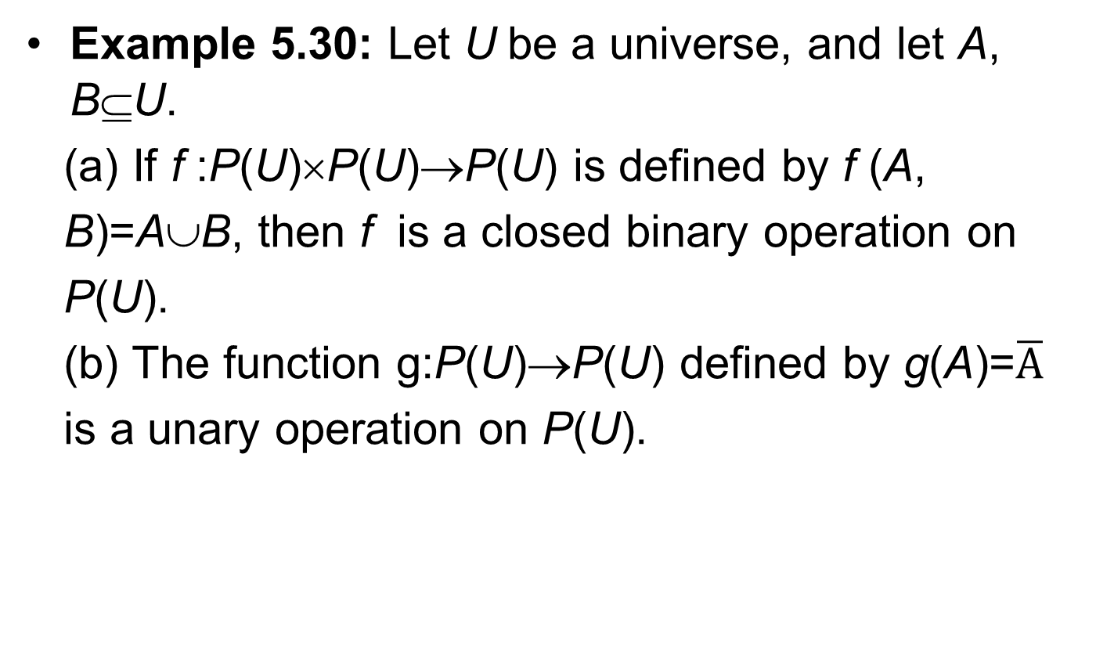
Binary / Unary operation (3/7)
Example 5.30: Let U be a universe, and let A, B⊆U.
(a) If f :P(U)×P(U)→P(U) is defined by f (A,
B)=A∪B, then f is a closed binary operation on
P(U).
(b) The function g:P(U)→P(U) defined by g(A)=$\overline{A}$
is a unary operation on P(U).

Slide 39
Binary / Unary operation (4/7)
Definition 5.12: Let f :A×A→B; that is, f is a
binary operation on A.
a) f is said to be commutative if f (a, b)=f (b, a)
for all (a, b)∈A×A.
b) When B⊆A (that is, when f is closed), f is said
to be associative if for a, b, c∈A, f (f(a, b),c)=f(a,
f(b, c)).

Slide 40
Binary / Unary operation (5/7)
Example 5.32:
(a)Define the closed binary operation f :Z×Z→Z
by f (a, b)=a+b-3ab. Since both the addition and
the multiplication of integers are commutative
binary operations, it follows that f (a, b)=a+b-
3ab=b+a-3ba=f(b, a), so f is commutative. To
determine whether f is associative, consider a, b,
c∈Z. Then f (a, b)=a+b-3ab and f (f (a, b), c)=f
(a, b)+c−3f (a, b)c=(a+b-3ab)+c-3(a+b-3ab)c
=a+b+c-3ab-3ac−3bc+9abc, whereas

Slide 41
Binary / Unary operation (6/7)
Example 5.32 (cont.):
f(b, c)=b+c-3bc and f(a,f (b, c))
=a+f (b, c)-3af (b, c)
=a+(b+c-3bc)-3a(b+c-3bc)
=a+b+c-3ab-3ac-3bc+9abc
Since f(f(a, b), c)=f(a,f(b, c)) for all a, b, c∈Z,
the closed binary operation f is associative as
well as commutative.

Slide 42
Binary / Unary operation (7/7)
Example 5.32 (cont.):
(b)Consider the closed binary operation h:Z×Z→Z,
where h(a, b)=a|b|. Then h(3, -2)=3|-2|=3(2)=6,
but h(-2, 3)=-2|3|=-6. Consequently, h is not
commutative. However, with regard to the
associative property, if a, b, c∈Z, we find that
h(h(a, b), c)=h(a, b)|c|=a|b||c| and
h(a,h(b,c))=a|h(b, c)|=a|b|c||=a|b||c|, so the closed
binary operation h is associative.

Slide 43
Identity (1/8)
Definition 5.13: Let f :A×A→B be a binary operation on A. An element x∈A is called an identity (or identity element) for f if f (a, x)=f (x, a)=a, for all a∈A.
Example 5.34:
a) Consider the (closed) binary operation f
:Z×Z→Z, where f(a, b)=a+b. Here the integer 0
is an identity since f(a, 0)=a+0=0+a=f(0, a)=a,
for any integer a.

Slide 44
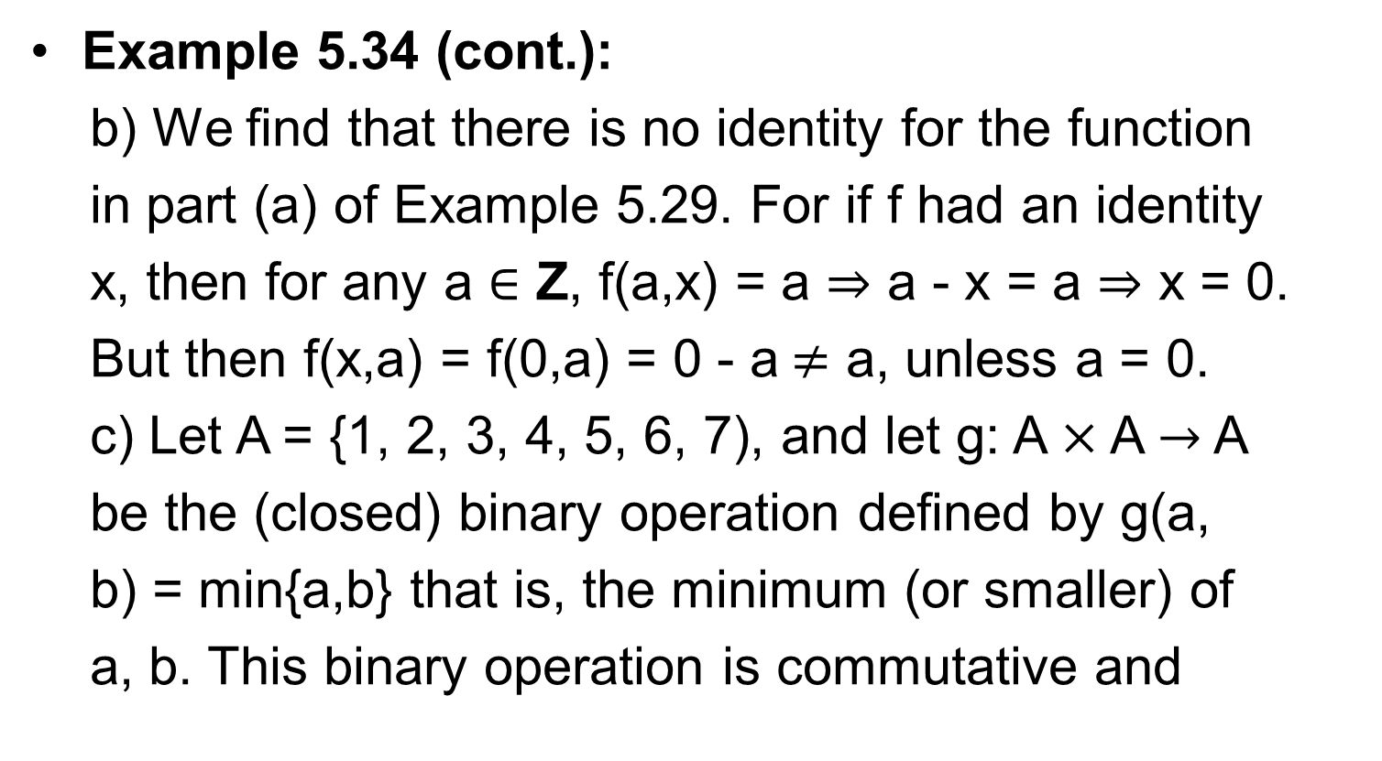
Identity (2/8)
Example 5.34 (cont.):
b) We find that there is no identity for the function
in part (a) of Example 5.29. For if f had an identity
x, then for any a $∈$ Z, f(a,x) = a $⇒$ a - x = a $⇒$ x = 0.
But then f(x,a) = f(0,a) = 0 - a$≠$ a, unless a = 0.
c) Let A = {1, 2, 3, 4, 5, 6, 7), and let g: A$×$ A$→$ A
be the (closed) binary operation defined by g(a,
b) = min{a,b} that is, the minimum (or smaller) of
a, b. This binary operation is commutative and

Slide 45
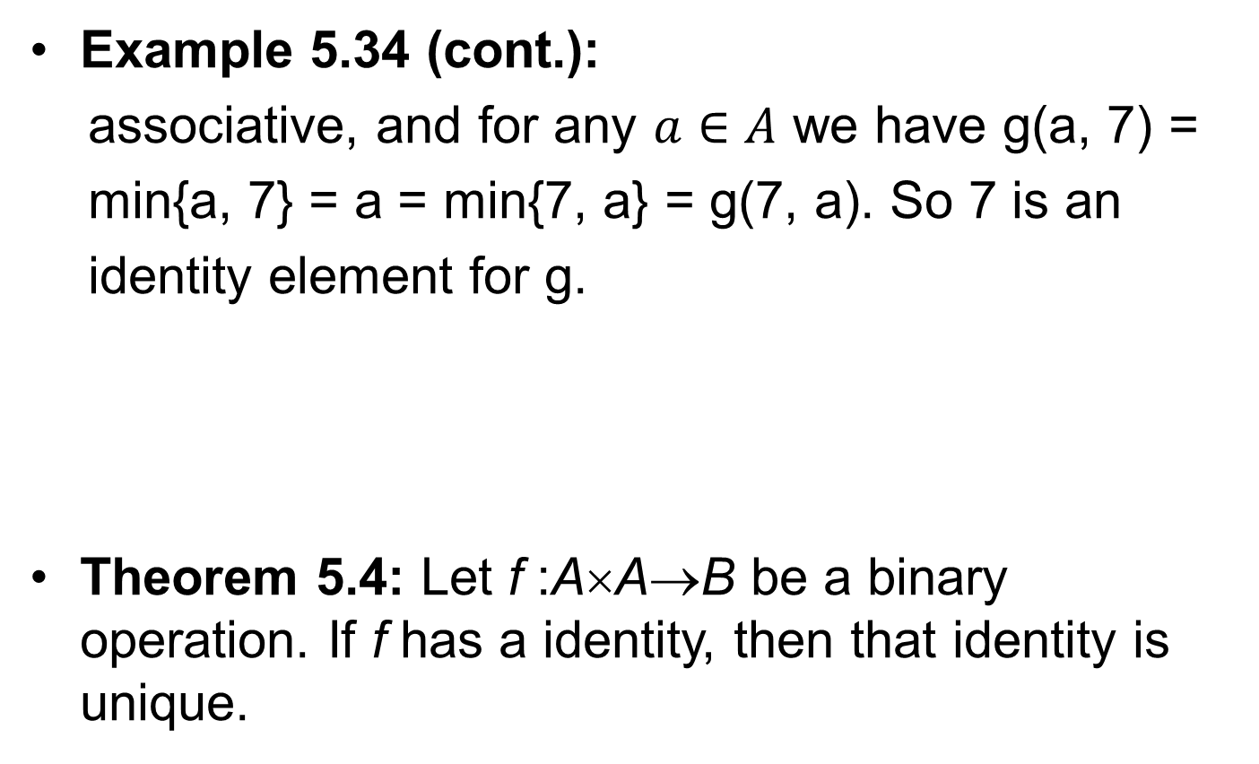
Identity (3/8)
Example 5.34 (cont.):
associative, and for any $a∈A$ we have g(a, 7) =
min{a, 7} = a = min{7, a} = g(7, a). So 7 is an
identity element for g.
Theorem 5.4: Let f :A×A→B be a binary operation. If f has a identity, then that identity is unique.

Slide 46
Identity (4/8)
Theorem 5.4 (cont.):
Proof: If f has more than one identity, let
x₁x₂∈A with f (a, x₁)=a=f (x₁, a), for all a∈A,
and f (a, x₂)=a=f (x₂, a), for all a∈A. Consider
x₁ as an element of A and x₂ as an identity.
Then f (x₁, x₂)=x₁. Now reverse the roles of x₁
and x₂—that is, consider x₂ as an element of A
and x₁ as an identity. We find that f (x₁, x₂)=x₂.
Consequently, x₁= x₂, and f has at most one
identity.

Slide 47
Identity (5/8)
Example 5.35: If A={x, a, b, c, d}, how many closed binary operations on A have x as the identity?
Let f :A×A→A with f (x, y)=y=f (y, x) for all y∈A.
Then we may represent f by a tables as in Table
5.2. Here the nine values, where x is the first
component—as in (x, c), or the second
component—as in (d, x), are determined by the
fact that x is the identity element.

Slide 48
Identity (6/8)
Example 5.35 (cont.):
Each of the 16 remaining (vacant) entries in
Table 5.2 can be filled with any one of the five
elements in A.
Table 5.2
f | x a b c d
x a b c d | x a b c d a _ _ _ _ b _ _ _ _ c _ _ _ _ d _ _ _ _

Slide 49
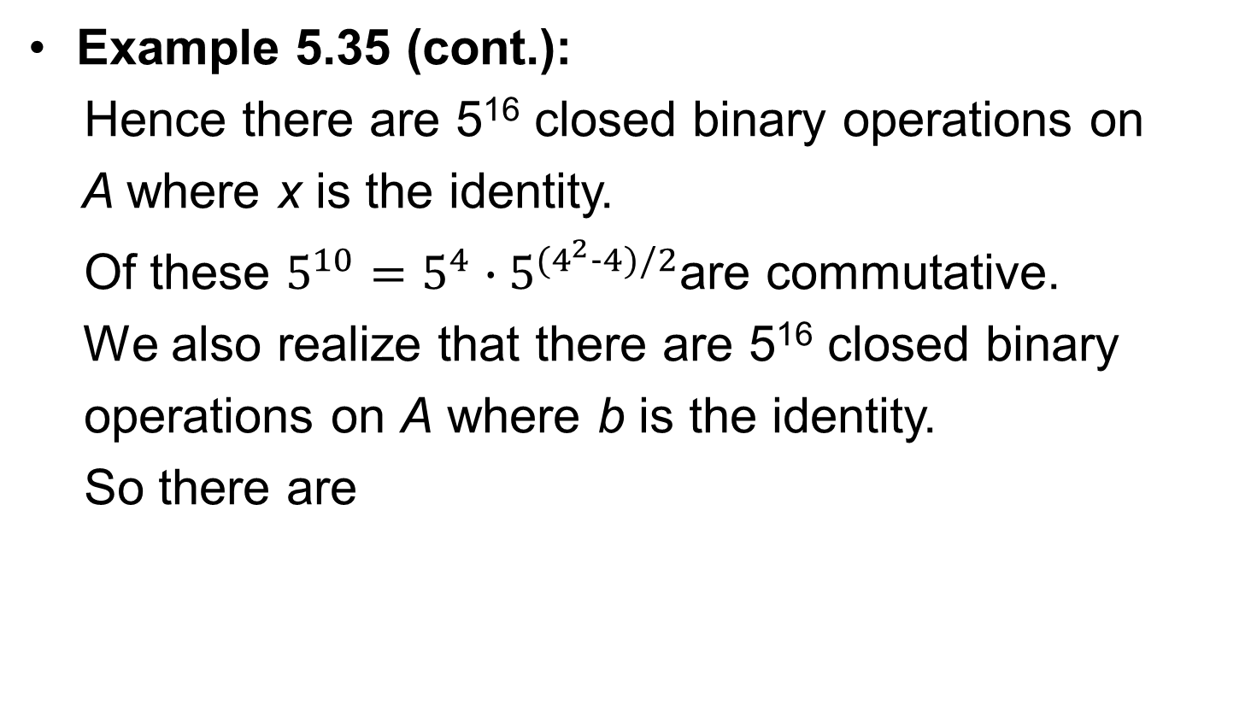
Identity (7/8)
Example 5.35 (cont.):
Hence there are 5¹⁶ closed binary operations on
A where x is the identity.
Of these $5^{10}=5^{4}∙5^{(4^{2}−4)/2}$are commutative.
We also realize that there are 5¹⁶ closed binary
operations on A where b is the identity.
So there are

Slide 50
Identity (8/8)
Example 5.35 (cont.):
close binary operations on A that have an
identity, and of these
are commutative.

Slide 51
Outline
Cartesian Products and Relations
Functions: Plain and one-to-one
Onto Functions: Stirling Numbers of the Second Kind
Special Functions
The Pigeonhole Principle
Function Composition and Inverse Function

Slide 52
Pigeonhole Principle (1/15)
Definition : If m pigeons occupy n pigeonholes and m>n, then at least one pigeonhole has two or more pigeons roosting in it.
Example 5.39: An office employs 13 file clerks, so at least two of them must have birthdays during the same month. Here we have 13 pigeons (the file clerks) and 12 pigeonholes (the months of the year).

Slide 53
Pigeonhole Principle (2/15)
Example 5.40: Larry returns from the laundromat with 12 pairs of socks (each pair a different color) in a laundry bag. Drawing the socks from the bag randomly, he’ll have to draw at most 13 of them to get a matched pair.
Example 5.41: Wilma operates a computer with a magnetic tape drive. One day she is given a tape that contains 500,000 “words” of four or fewer lowercase letters. (Consecutive words on the tape are separated by a blank character.) Can it be that the 500,000 words are all distinct?

Slide 54
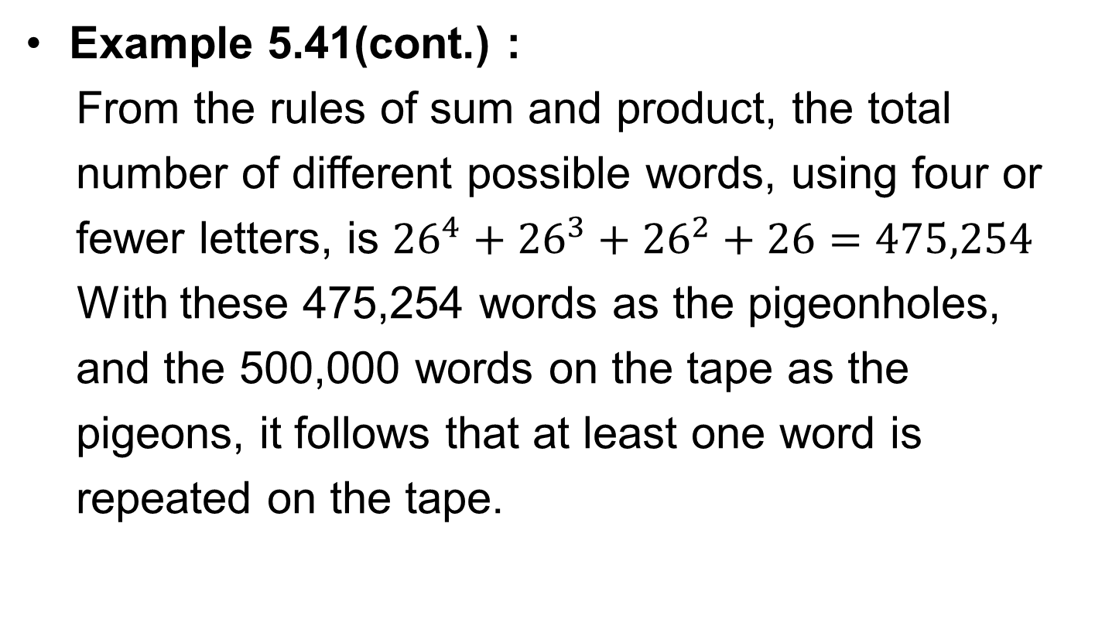
Pigeonhole Principle (3/15)
Example 5.41(cont.) :
From the rules of sum and product, the total
number of different possible words, using four or
fewer letters, is ${26}^{4}+{26}^{3}+{26}^{2}+26=475,254$
With these 475,254 words as the pigeonholes,
and the 500,000 words on the tape as the
pigeons, it follows that at least one word is
repeated on the tape.

Slide 55
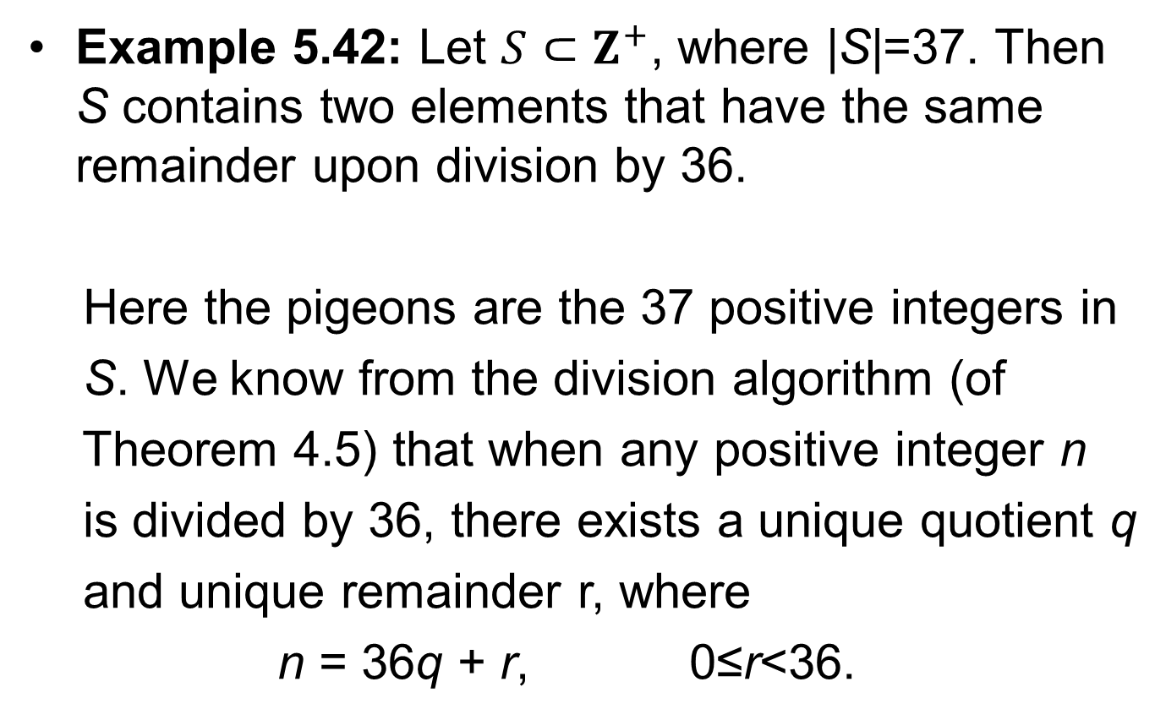
Pigeonhole Principle (4/15)
Example 5.42: Let $S⊂Z^{+}$, where |S|=37. Then S contains two elements that have the same remainder upon division by 36.
Here the pigeons are the 37 positive integers in
S. We know from the division algorithm (of
Theorem 4.5) that when any positive integer n
is divided by 36, there exists a unique quotient q
and unique remainder r, where
n = 36q + r, 0≤r<36.

Slide 56
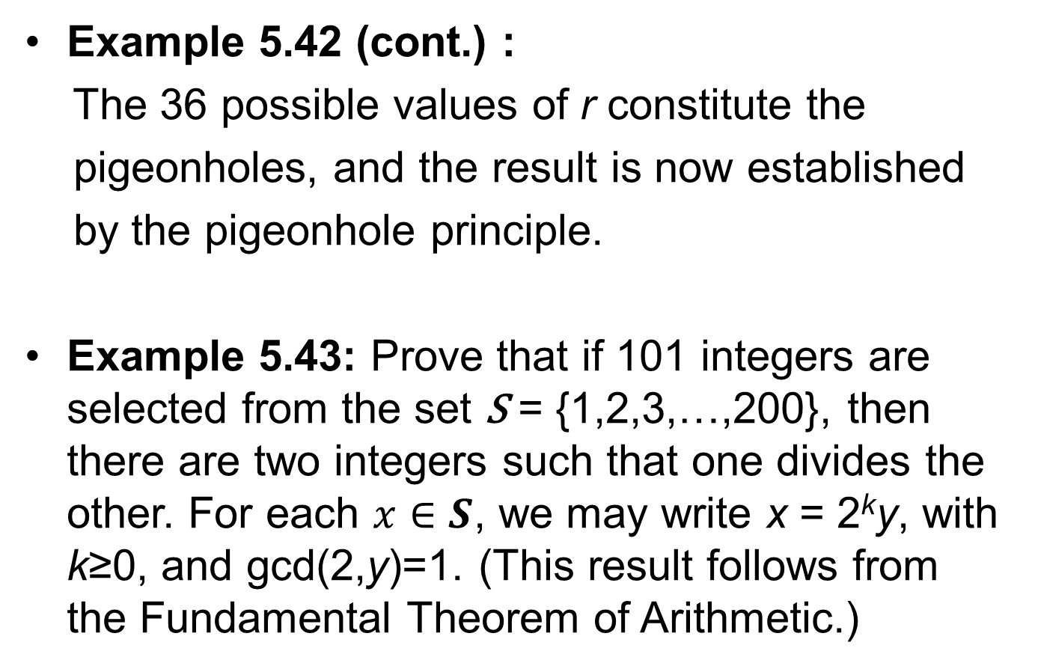
Pigeonhole Principle (5/15)
Example 5.42 (cont.) :
The 36 possible values of r constitute the
pigeonholes, and the result is now established
by the pigeonhole principle.
Example 5.43: Prove that if 101 integers are selected from the set S = {1,2,3,…,200}, then there are two integers such that one divides the other. For each $x∈S$, we may write x = 2^{k}y, with k≥0, and gcd(2,y)=1. (This result follows from the Fundamental Theorem of Arithmetic.)

Slide 57
Pigeonhole Principle (6/15)
Example 5.43 (cont.):
Then y ∈ T = {1,3,5,…,199}, where |T|=100. Since
101 integers are selected from S, by the pigeonhole
principle there are two distinct integers of the form
a=2^{m}y, b=2^{n}y for some (the same) y ∈ T. If m<n,
then a|b; otherwise, we have m>n and then b|a.

Slide 58
Pigeonhole Principle (7/15)
Example 5.44: Any subset of size six from the set S={1, 2, 3,…, 9} must contain two elements whose sum is 10.
Here the numbers 1, 2, 3,…, 9 are the pigeons,
and the pigeonholes are the subsets {1, 9},
{2, 8}, {3, 7}, {4, 6}, {5}. When six pigeons go to
their respective pigeonholes, they must fill at
least one of two-element subsets whose
members sum to 10.

Slide 59
Pigeonhole Principle (8/15)
Example 5.46: Let S be a set of six positive integers whose maximum is at most 14. Show that the sums of the elements in all the nonempty subsets of S cannot all be distinct.
For each nonempty subset A of S, the sum of the elements in A, denoted s_{A}, satisfies 1≤s_{A}≤9+10+…+14=69, and there are 2⁶-1=63 nonempty subsets of S.

Slide 60
Pigeonhole Principle (9/15)
Example 5.46 (cont.):
We should like to draw the conclusion from the
pigeonhole principle by letting the possible
sums, from 1 to 69, be the pigeonholes, with the
63 nonempty subsets of S as the pigeons, but
then we have too few pigeons.
So instead of considering all nonempty subsets
of S, we cut back to those nonempty subsets A
of S where |A|≤5.

Slide 61
Pigeonhole Principle (10/15)
Example 5.46 (cont.):
Then for each such subset A it
follows that 1≤s_{A}≤10+11+…+14=60. There are
62 nonempty subsets A of S with |A|≤5—namely,
all the subsets of S except for and the set S
itself. With 62 pigeons (the nonempty subsets A
of S where |A|≤5) and 60 pigeonholes (the
possible sums s_{A}), it follows by the pigeonhole
principle that the elements of at least two of
theses 62 subsets must yield the same sum.

Slide 62
Pigeonhole Principle (11/15)
Example 5.49: Let us start by considering two particular examples:
1) Note how the sequences 6,5,8,3,7 (of length 5)
contains the decreasing subsequence 6,5,3 (of
length 3).
2) Now note how the sequence
11,8,7,1,9,6,5,10,3,12 (of length 10) contains the
increasing subsequence 8,9,10,12 (of length 4).

Slide 63
Pigeonhole Principle (12/15)
Example 5.49 (cont.):
These two instances demonstrate the general
result: For each n∈Z⁺, a sequence of n²+1
distinct real numbers contains a decreasing or
increasing subsequence of length n+1.
To verify this claim let a₁,a₂,…,a_{n}2₊₁ be a
sequence of n²+1 distinct real numbers. For
1≤k≤n²+1, let x_{k} = the maximum length of a
decreasing subsequence that ends with a_{k},

Slide 64
Pigeonhole Principle (13/15)
Example 5.49 (cont.):
and y_{k} = the maximum length of an increasing
subsequence that ends with a_{k}.
For instance, our second particular example
would provide
k 1 2 3 4 5 6 7 8 9 10
a_{k} 11 8 7 1 9 6 5 10 3 12
x_{k} 1 2 3 4 2 4 5 2 6 1
y_{k} 1 1 1 1 2 2 2 3 2 4

Slide 65
Pigeonhole Principle (14/15)
Example 5.49 (cont.):
If, in general, there is no decreasing or
increasing subsequence of length n+1, the
1≤x_{k}≤n and 1≤y_{k}≤n for all 1≤k≤n²+1.
Consequently, there are at most n² distinct
ordered pairs (x_{k},y_{k}). But we have n²+1 ordered
pairs (x_{k},y_{k}), since 1≤k≤n²+1. So the pigeonhole
principle implies that there are two identical
ordered pairs (x_{i},y_{i}), (x_{j},y_{j}), where i≠j—say i<j.

Slide 66
Pigeonhole Principle (15/15)
Example 5.49 (cont.):
Now the real numbers a₁, a₂,…,a_{n}2₊₁ are distinct,
so if a_{i}<a_{j} then y_{i}<y_{j}, while if a_{j}<a_{i} then x_{j}>x_{i}. In
either case we no longer have (x_{i},y_{i})=(x_{j},y_{j}). This
contradiction tells us that x_{k}=n+1 or y_{k}=n+1 for
some n+1≤k≤n²+1; the result then follows.

Slide 67
Outline
Cartesian Products and Relations
Functions: Plain and one-to-one
Onto Functions: Stirling Numbers of the Second Kind
Special Functions
The Pigeonhole Principle
Function Composition and Inverse Function

Slide 68
Bijective
Definition 5.15: If f :A→B, then f is said to be bijective, or to be a one-to-one correspondence, if f is both one-to-one and onto.
Example 5.50: If A={1, 2, 3, 4} and B={w, x, y, z}, then f ={(1, w), (2, x), (3, y), (4, z)} is a one-to-one correspondence from A (on) to B, and g={(w, 1), (x, 2), (y, 3), (z, 4)} is a one-to-one correspondence from B (on) to A.

Slide 69
Identity Function
Definition 5.16: The function 1_{A}:A→A, defined by 1_{A}(a)=a for all a∈A, is called the identity function for A.
Definition 5.17: If f, g:A→B, we say that f and g are equal and write f=g if f(a)=g(a) for all a∈A.

Slide 70
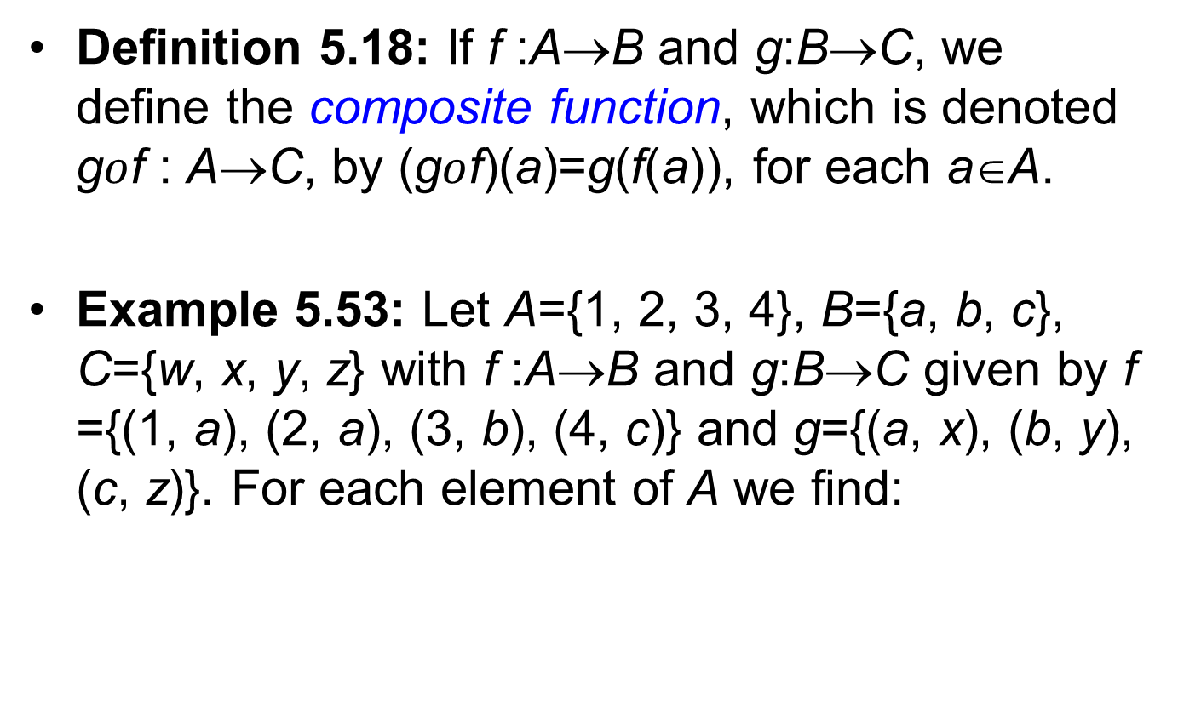
Composite Function (1/4)
Definition 5.18: If f :A→B and g:B→C, we define the composite function, which is denoted g$ο$f : A→C, by (g$ο$f)(a)=g(f(a)), for each a∈A.
Example 5.53: Let A={1, 2, 3, 4}, B={a, b, c}, C={w, x, y, z} with f :A→B and g:B→C given by f ={(1, a), (2, a), (3, b), (4, c)} and g={(a, x), (b, y), (c, z)}. For each element of A we find:

Slide 71
Composite Function (2/4)
Example 5.53 (cont.):
so

Slide 72
Composite Function (3/4)
Theorem 5.6: If f :A→B, g:B→C and h:C→D, then
Proof: Since the two functions have the same
domain, A, and codomain, D, the result will
follow by showing that for every x∈A,
(See the diagram shown in Fig.5.8.)
Using the definition of the composite function, we
find that

Slide 73
Composite Function (4/4)
Theorem 5.6 (cont.):
Consequently, the composition of functions is an
associate operation.
Figure 5.8
f
g
h
A
B
C
D

Slide 74
Invertible (1/5)
Definition 5.21: If f :A→B, then f is said to be invertible if there is a function g:B→A such that
Example 5.58: Let f , g:R→R be defined by f(x)=2x+5, g(x)=(1/2)(x-5). Then
Consequently, f and g are both invertible functions.

Slide 75
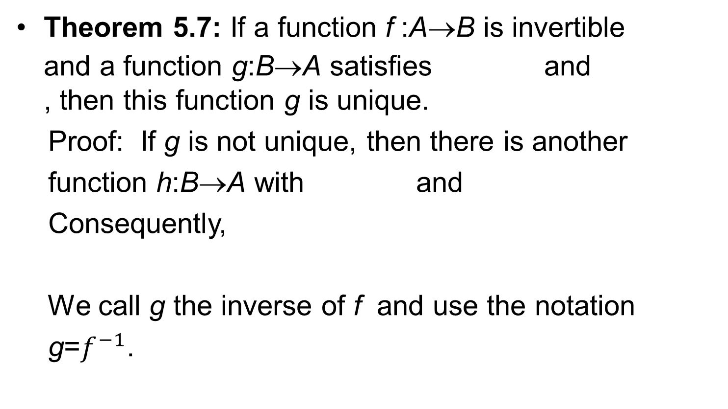
Invertible (2/5)
Theorem 5.7: If a function f :A→B is invertible and a function g:B→A satisfies and , then this function g is unique.
Proof: If g is not unique, then there is another
function h:B→A with and
Consequently,
We call g the inverse of f and use the notation
g=$f^{−1}$.

Slide 76
Invertible (3/5)
Theorem 5.8: A function f :A→B is invertible if and only if it is one-to-one and onto.
Example 5.59: From Theorem 5.8 it follows that the function f₁:R→R defined by f ₁(x)=x² is not invertible (it is neither one-to-one nor onto), but
defined by
is invertible with

Slide 77

Invertible (4/5)
Example 5.60: For m, b∈R, m≠0, the function f :R→R defined by f ={(x, y)|y=mx+b} is an invertible function, because it is one-to-one and onto. To get $f^{−1}$we note that
So f :R→R is defined by , and
$f^{−1}$:R→R is defined by
This is where we wish to
change the components of
the ordered pairs of f.

Slide 78
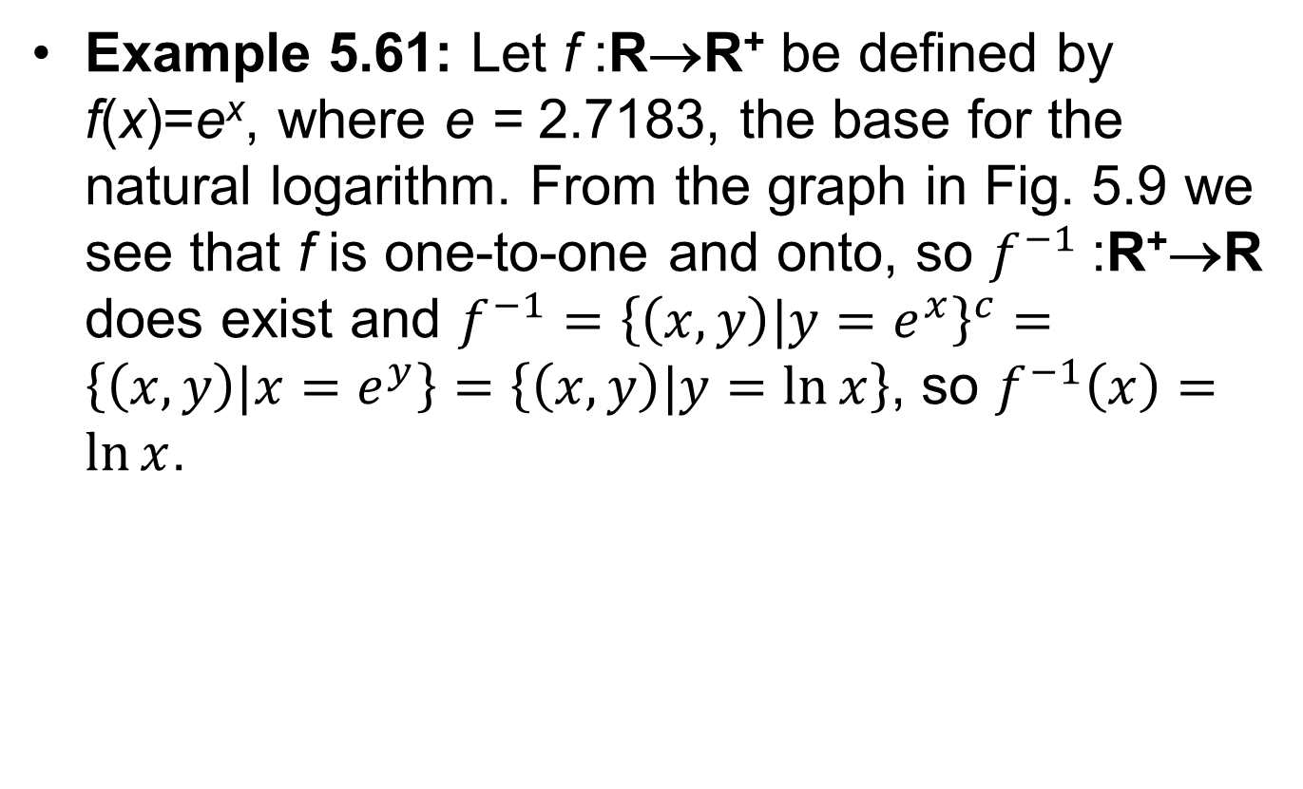
Invertible (5/5)
Example 5.61: Let f :R→R⁺ be defined by f(x)=e^{x}, where e = 2.7183, the base for the natural logarithm. From the graph in Fig. 5.9 we see that f is one-to-one and onto, so $f^{−1}$:R⁺→R does exist and $f^{−1}={\left\{\left(x,y\right)|y=e^{x}\right\}}^{c}=\left\{\left(x,y\right)|x=e^{y}\right\}=\left\{\left(x,y\right)|y=\ln{x}\right\}$, so $f^{−1}\left(x\right)=\ln{x}$.

Slide 79
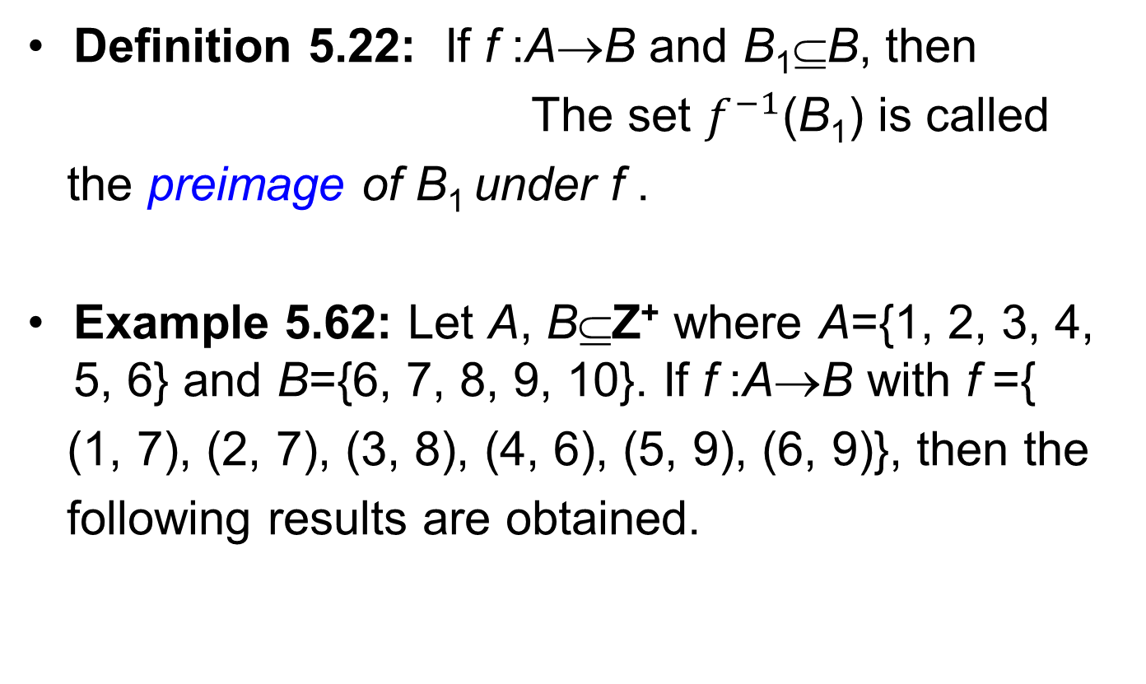
Preimage (1/3)
Definition 5.22: If f :A→B and B₁⊆B, then
The set $f^{−1}$(B₁) is called
the preimage of B₁ under f .
Example 5.62: Let A, B⊆Z⁺ where A={1, 2, 3, 4, 5, 6} and B={6, 7, 8, 9, 10}. If f :A→B with f ={
(1, 7), (2, 7), (3, 8), (4, 6), (5, 9), (6, 9)}, then the
following results are obtained.

Slide 80
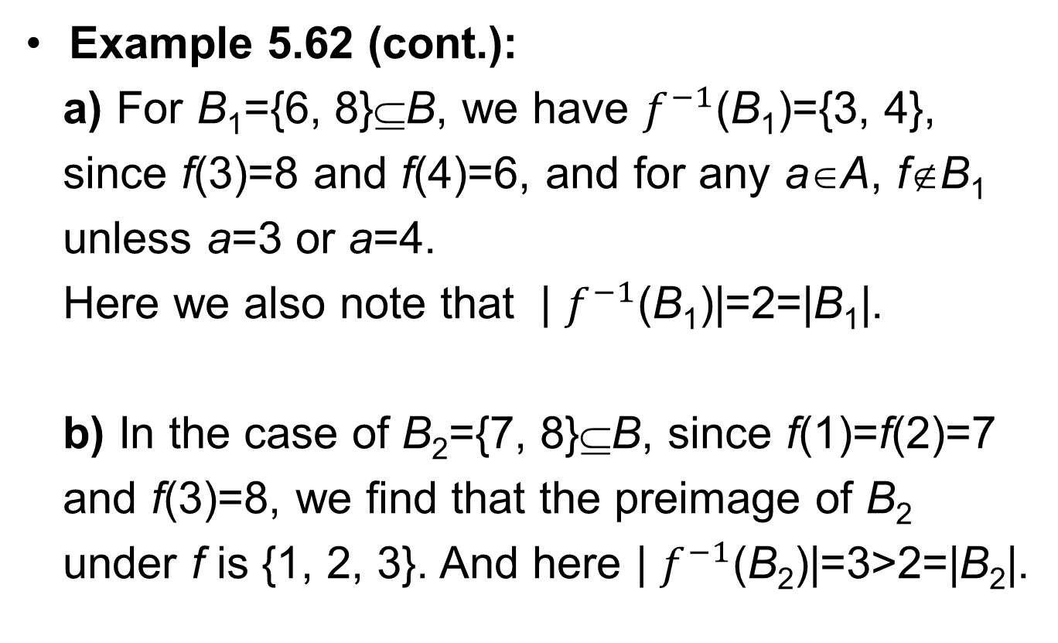
Preimage (2/3)
Example 5.62 (cont.):
a) For B₁={6, 8}⊆B, we have $f^{−1}$(B₁)={3, 4},
since f(3)=8 and f(4)=6, and for any a∈A, f∉B₁
unless a=3 or a=4.
Here we also note that | $f^{−1}$(B₁)|=2=|B₁|.
b) In the case of B₂={7, 8}⊆B, since f(1)=f(2)=7
and f(3)=8, we find that the preimage of B₂
under f is {1, 2, 3}. And here | $f^{−1}$(B₂)|=3>2=|B₂|.

Slide 81
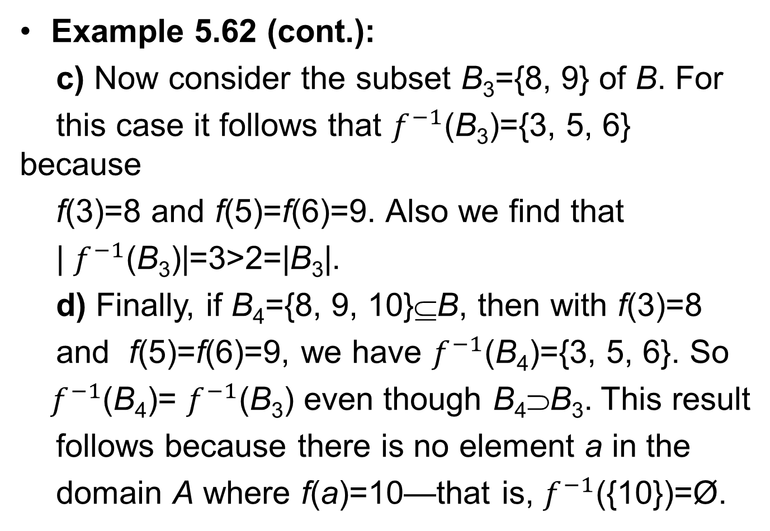
Preimage (3/3)
Example 5.62 (cont.):
c) Now consider the subset B₃={8, 9} of B. For
this case it follows that $f^{−1}$(B₃)={3, 5, 6} because
f(3)=8 and f(5)=f(6)=9. Also we find that
| $f^{−1}$(B₃)|=3>2=|B₃|.
d) Finally, if B₄={8, 9, 10}⊆B, then with f(3)=8
and f(5)=f(6)=9, we have $f^{−1}$(B₄)={3, 5, 6}. So
${ f}^{−1}$(B₄)= $f^{−1}$(B₃) even though B₄⊃B₃. This result
follows because there is no element a in the
domain A where f(a)=10—that is, $f^{−1}$({10})=Ø.

Slide 82
Homework Assignment #2
EXERCISES 5.4
6, 8
EXERCISES 5.5
2, 4
EXERCISES 5.6
2, 22

